Slide 1
IOT Project Distance sensor
Students name:
Renad Aladwani Shahad Alharbi
2005857 2113525
Lama Almalki Souad Ridwan
2111750 2115094

Slide 2
TABLE OF CONTENTS
01
02
03
04
PROJECT IDEA
FLOW OF WORK
Project description
Application in real life
Sensor type
Hardware
Software
FACED PROPLEMS
TESTING
Description of the Challenges
Demo video

Slide 3
PROJECT IDEA
Estimate the distance between the sensor and any object.
when the object is closer than 10 cm An alert will start to make sounds and it automatically will send an email.

Slide 4
automobile self-parking technology
Applications in real life

Slide 5
liquid level measurement
Applications in real life

Slide 6
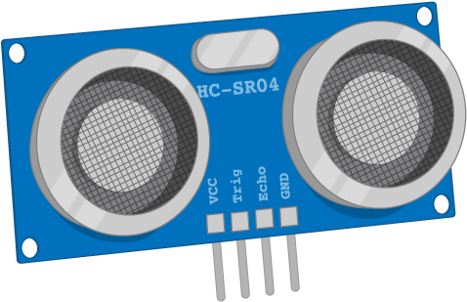
ULTRASONIC SENSOR
SENSOR TYEP:

Slide 7
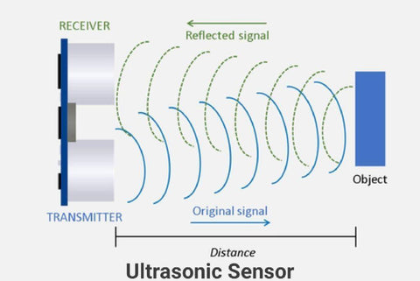
How its work ?
SENSOR TYEP:

Slide 8
Connect hardware with software
The Distance sensor has fourth parties , positive party , ground party , trigger party and echo party. The trigger and ego parties we connected with the node MCU.
One of the buzzer party connected with node MCU and the other one connected with the ground.

Slide 9
Connect hardware with software
One of the led party connected with node MCU and the other one connected with the ground.
The node MCU we programmed it to do specific task to controlled the electrical circuit

Slide 10
Connect hardware with software

Slide 11
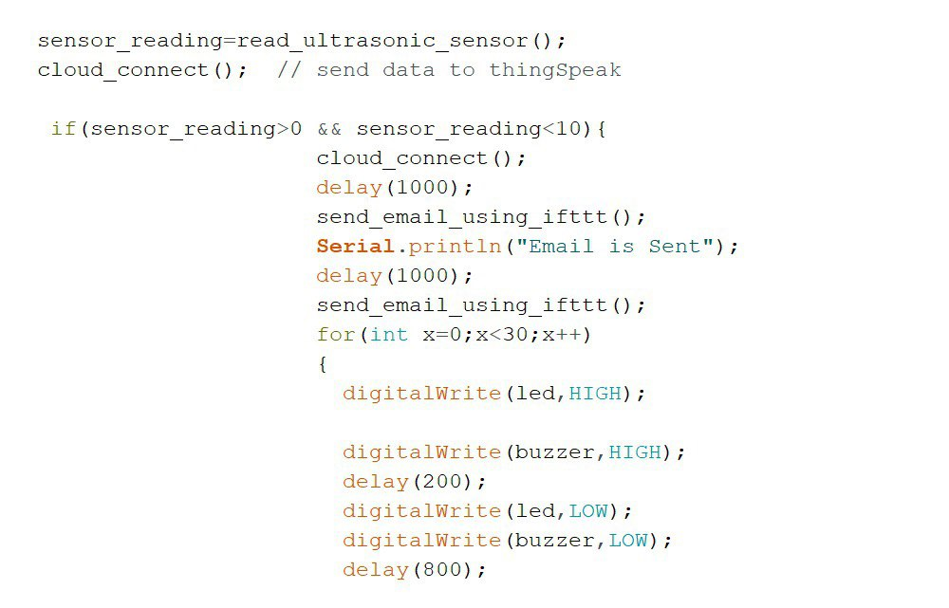
Code application

Slide 12
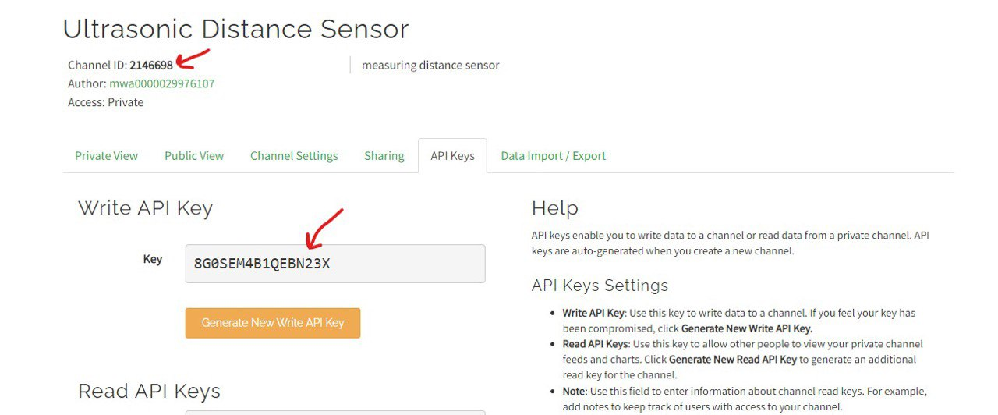
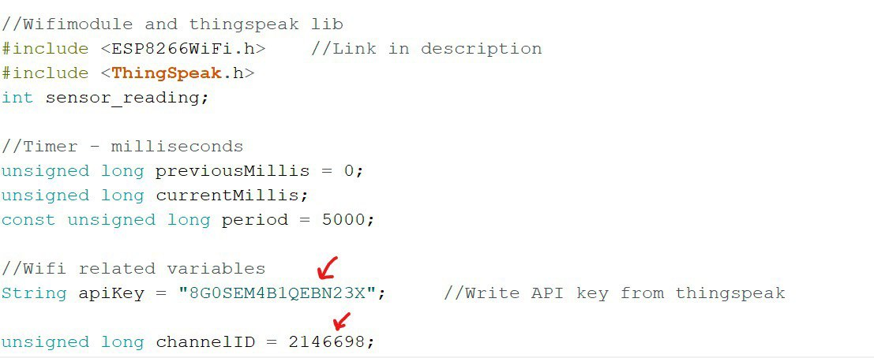
Matching channel ID and API key in the code and Thingspeak
Code application
Thingspeak
Code

Slide 13
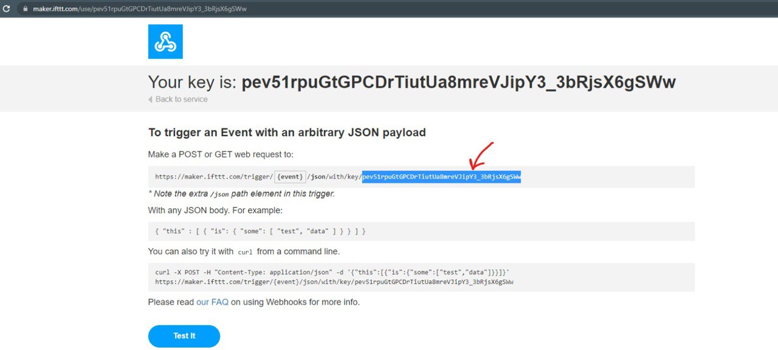
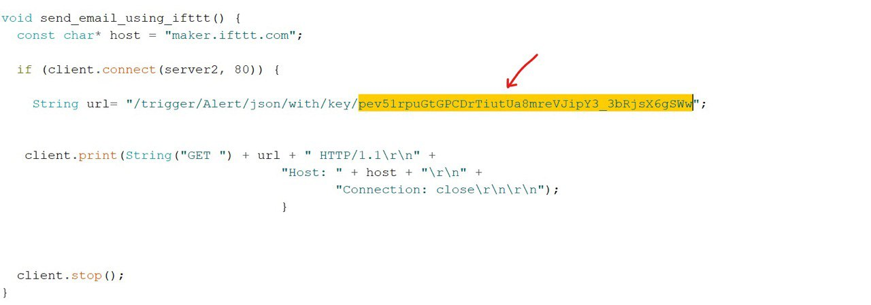
Matching the key in the code and IFTTT
Code application
IFTTT
Code

Slide 14
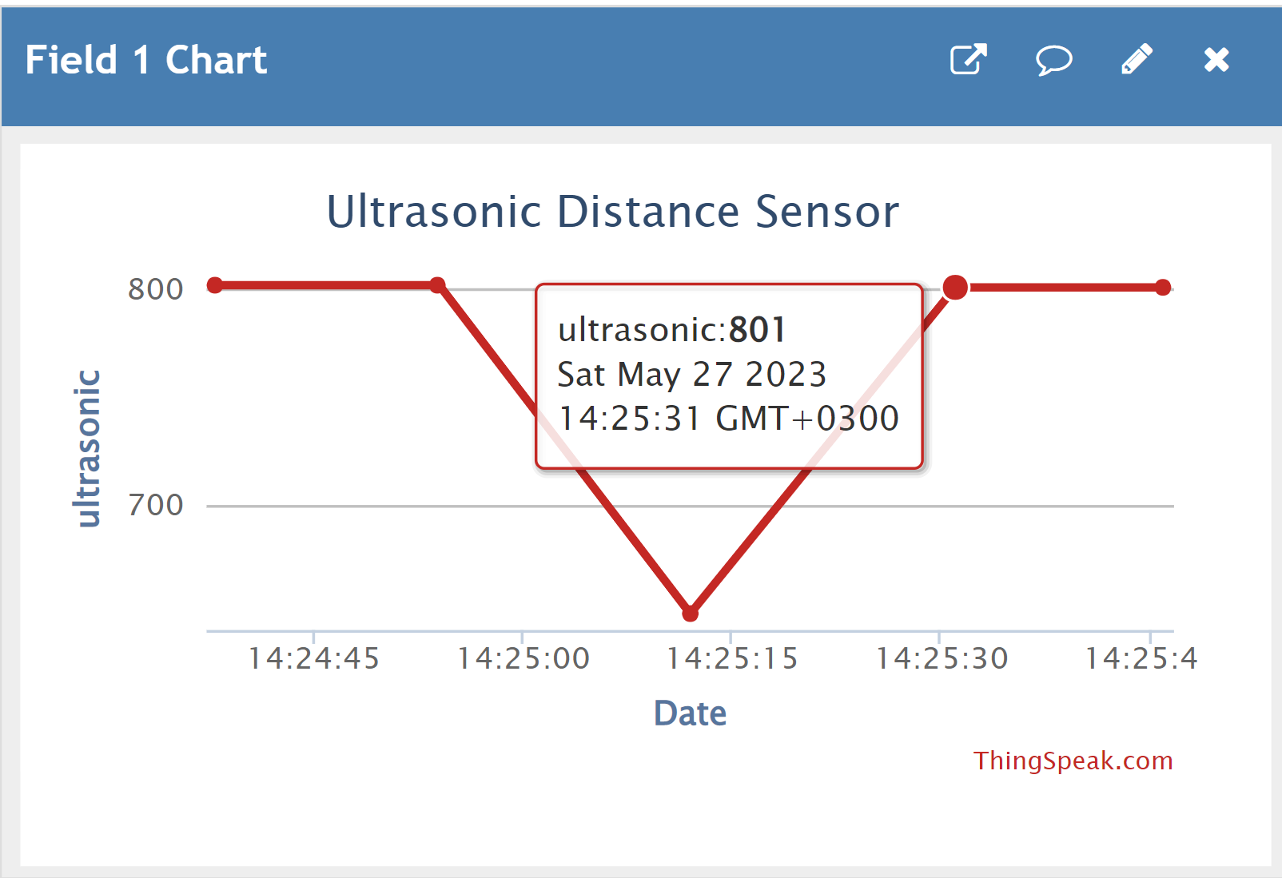
Connect hardware with software
Thingspeak

Slide 15
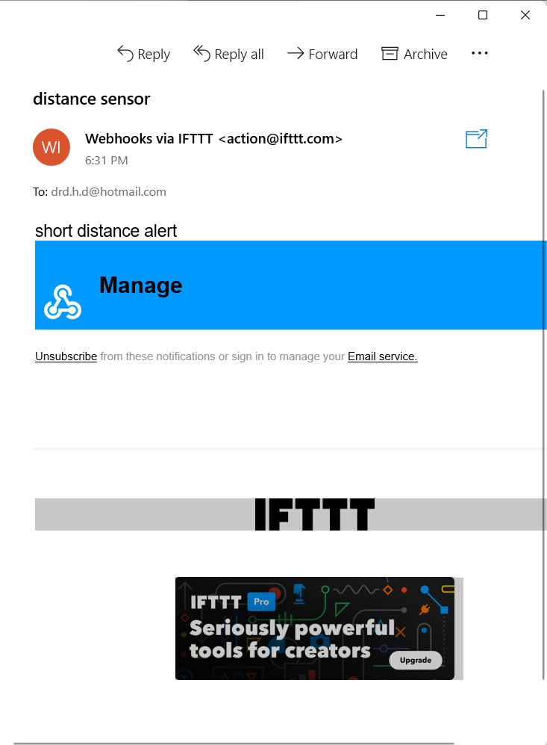
Connect hardware with software
IFTTT

Slide 16
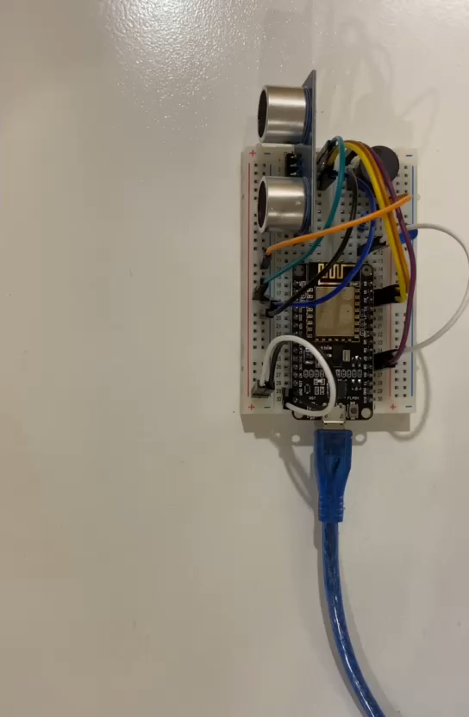
Demo video

Slide 17
What issues are we dealing with?
Repeatedly sending emails
The delay in email delivery
The slow response of the

Slide 18
We are grateful for your listening

